Slide 1

Multi Modal Route Planning
Presented By :
Anoop Toffy - MT2016016
Harshit Joshi – MT2016059
Mehul Singh – MT2016083
Mohd Awais - MT2016086

Slide 2
Introduction
For a traveler it is often reliable to use different modes of transport for a travel whenever it is available. But there are very few efficient systems to find such a travel plan, there are systems that aid traveler to choose different modes of transport, such as Google Transit.
Multimodal Route Planning(MRP) is a system that provides the traveler with optimal, feasible and personalized route plan between a given source and destination. The system is designed to provide combinations of various public travel approaches like bus and metro.

Slide 3
Related Work
Notes:
A brief overview of the works done by other people so far.Refer papers that we shared in GIT and add a brief overview of the same.

Slide 4
Proposed Solution
Defining The Input

Slide 5
Proposed Solution (cont...)
Modeling The Network

Slide 6
Proposed Solution (cont...)
Our Transit Algorithm

Slide 7
Demo

Slide 8
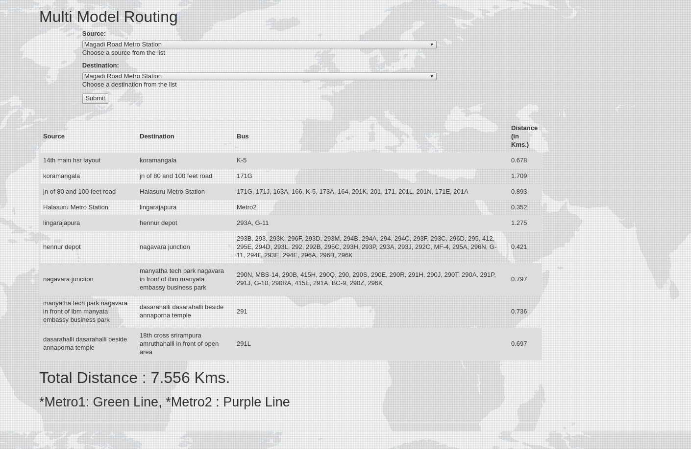
App in Motion

Slide 9
Technologies Used
Back-End
Python Programming Language
Front-End
Django Framework
Bootstrap Framework

Slide 10
Key Challenges

Slide 11
Future Work
Incorporating Pedestrians
Duration Constraint
Caching Repetitive queries
User location detection
Expanding model to other cities

Slide 12
References

Slide 13
Questions ?

Slide 14
Thank You!

